Slide 1


SRI RAMAKRISHNA ENGINEERING COLLEGE
[Educational Service : SNR Sons Charitable Trust]
[Autonomous Institution, Accredited by NAAC with ‘A’ Grade]
[Approved by AICTE and Permanently Affiliated to Anna University, Chennai]
[ISO 9001:2015 Certified and all Eligible Programmes Accredited by NBA]
VATTAMALAIPALAYAM, N.G.G.O. COLONY POST, COIMBATORE – 641 022.
ARTIFICIAL INTELLIGENCE AND DATA SCIENCE
20AD272- PROJECT WORK
TITLE: VISION BASED LANE ASSISTANCE SYSTEM
PROJECT MENTOR:
MR.M.LOGAPRAKASH, AP(SI.Gr)
DEPARTMENT OF ARTIFICIAL INTELLIGENCE AND DATA SCIENCE
TEAM MEMBER:
2011029 MONISHAA S

Slide 2
AGENDA
INTRODUCTION
LITERATURE SURVEY
PROBLEM STATEMENT
METHODOLOGY
SPECIFICATIONS
MODULES
RESULTS
CONCLUSION
FUTURE SCOPE
REFERENCES

Slide 3
INTRODUCTION
MACHINE LEARNING
Machine learning is a branch of artificial intelligence(AI) that allows software applications to become more accurate at predicting outcomes without being explicitly programmed.
INTERNET OF THINGS
The internet of things is a technology that allows us to add a device to an inert object that can measure environmental parameters , generate associated data and transmit them through a communication network.

Slide 4
LITERATURE REVIEW
Title | Author | Year of Publication | Description
Design and Analysis of an Orthotic Device with Torque Reducing Mechanism for Knee Joint during Normal Walking | Abhishek Rudra Pal, Dilipkumar Pratihar | 2019 | To evaluate the feasibility and effectiveness of a knee-ankle-foot orthosis powered by artificial pneumatic muscles (PKAFO).

Slide 5
LITERATURE REVIEW
Title | Author | Year of Publication | Description
Leg-orthosis contact force estimation from gait analysis | F Mouza , F Michaud , U Lugris , J Cuadrado | 2020 | To evaluate gait analysis using torque sensor and extensometry- based load cell

Slide 6
LITERATURE REVIEW
Title | Author | Year of Publication | Description
Effectiveness of an ankle–foot orthosis on walking in patients with stroke: a systematic review and meta-analysis | Yoo Jin Choo, Min Cheol Chang | 2021 | To reduce physical cost of patient by selecting the design parameters From systematic review and meta-analysis.

Slide 7
LITERATURE REVIEW
Title | Author | Year of Publication | Description
Smart Orthotic Brace: An IoT-Based Wearable System for Postural Correction and Gait Assistance | M. R. Hoque et al | 2021 | smart orthotic brace that uses IoT technology to monitor and correct posture and assist with gait.

Slide 8
PROBLEM STATEMENT
Gait abnormalities involve unusual walking patterns that may be caused by disease or injury. It can even be one of the reasons due to the change in food style patterns which involves the lack of exercises. Such irregularities can lead to pain in hips, back, neck, feet ,knees or ankles. There is a need to prevent the unnatural rotation of lower leg thereby treating the cause of this type of knee pain by supporting the arches they force the ankles and legs back into alignment to relief the painful knee joint.

Slide 9
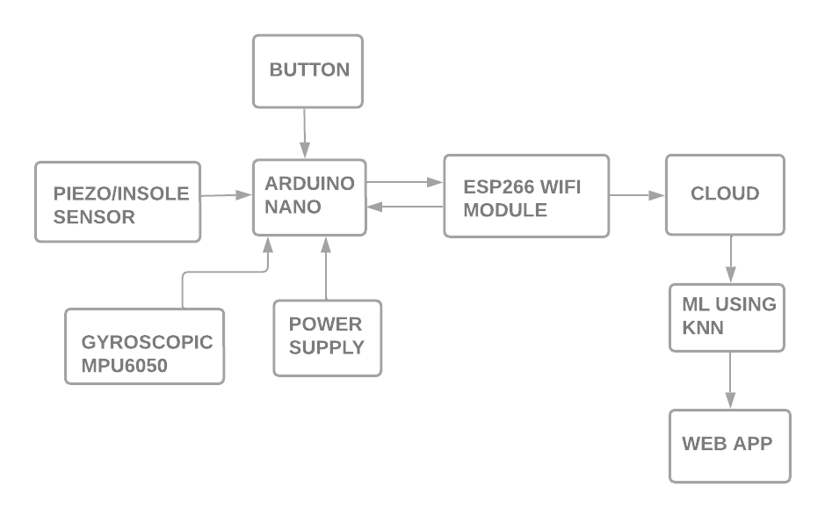
METHODOLOGY

Slide 10
HARDWARE SPECIFICATIONS
Piezoelectric sensor
Gyroscopic MPU6050
Adafruit sensor
Node MCU

Slide 11
SOFTWARE SPECIFICATION
Framework : React JS
Language : Javascript
Database : ThingSpeak
Code editor : VS code

Slide 12
MODULES
Hardware Module
Software Module

Slide 13
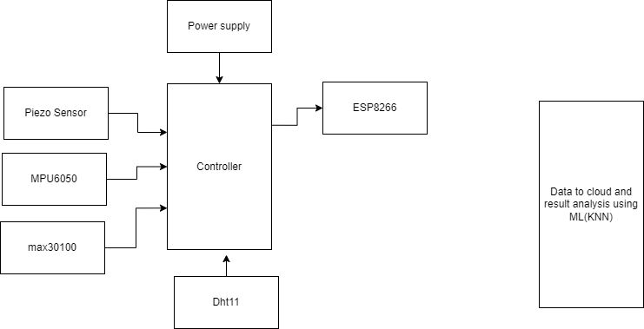
BLOCK DIAGRAM

Slide 14
HARDWARE MODULE
Piezoelectric sensor, adafruit sensor and gyroscopic sensor are connected to the Node MCU. The data from these sensors are received by Node MCU and sent to ThingSpeak cloud through inbuilt-wifi module. The collected data include pressure, temperature and orientation values.
A small LCD monitor is fixed on the top of the system which shows the readings of the measured values.

Slide 15
HARDWARE MODULE
The graphs for these data are generated in ThingSpeak using various visualization tools that are available in the cloud by creating a new channel and new API key is generated.

Slide 16
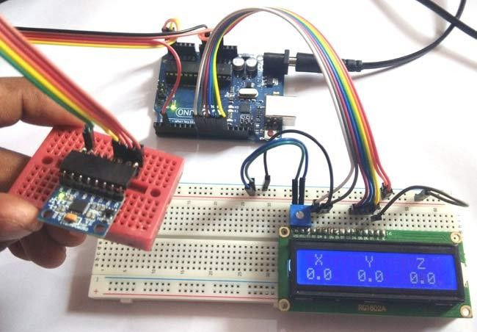
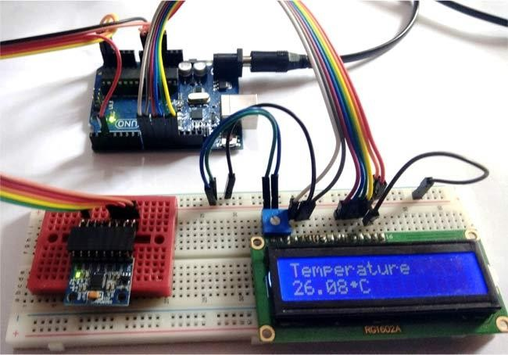
RESULTS

Slide 17
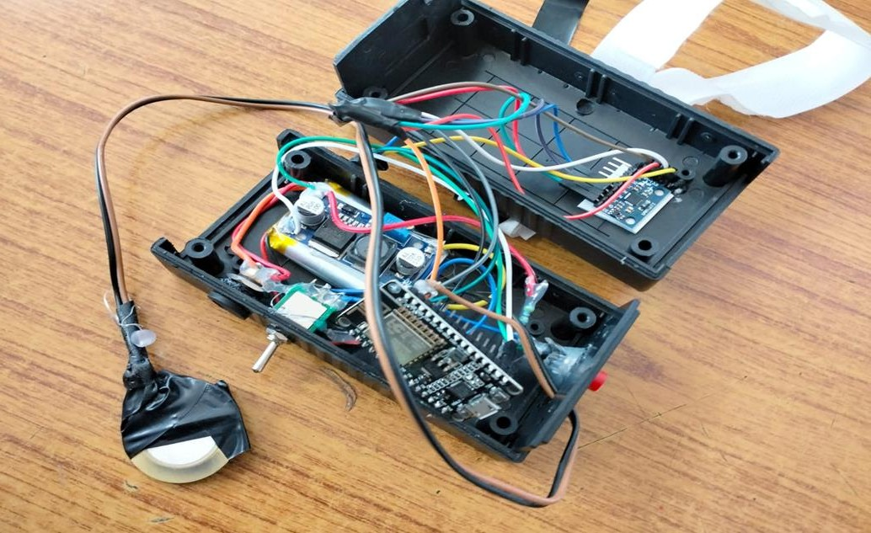
RESULTS

Slide 18
SOFTWARE MODULE
The graphs for these data are generated in ThingSpeak using various visualization tools that are available in the cloud by creating a new channel and new API key is generated.
After collecting the data from patients, the dataset is preprocessed to improve the quality of our ML model.

Slide 19
SOFTWARE MODULE
Machine learning algorithms like KNN, SVM and Decision trees are implemented for our dataset and got high accuracy of 92.5% with KNN model comparatively.
A web application is created using Vite+React JS framework for continuous monitoring and analysis of orthotic leg. This application will display the graphs of pressure, temperature and x,y,z coordinates of the gait pattern. And also display the output of the ML algorithm.

Slide 20
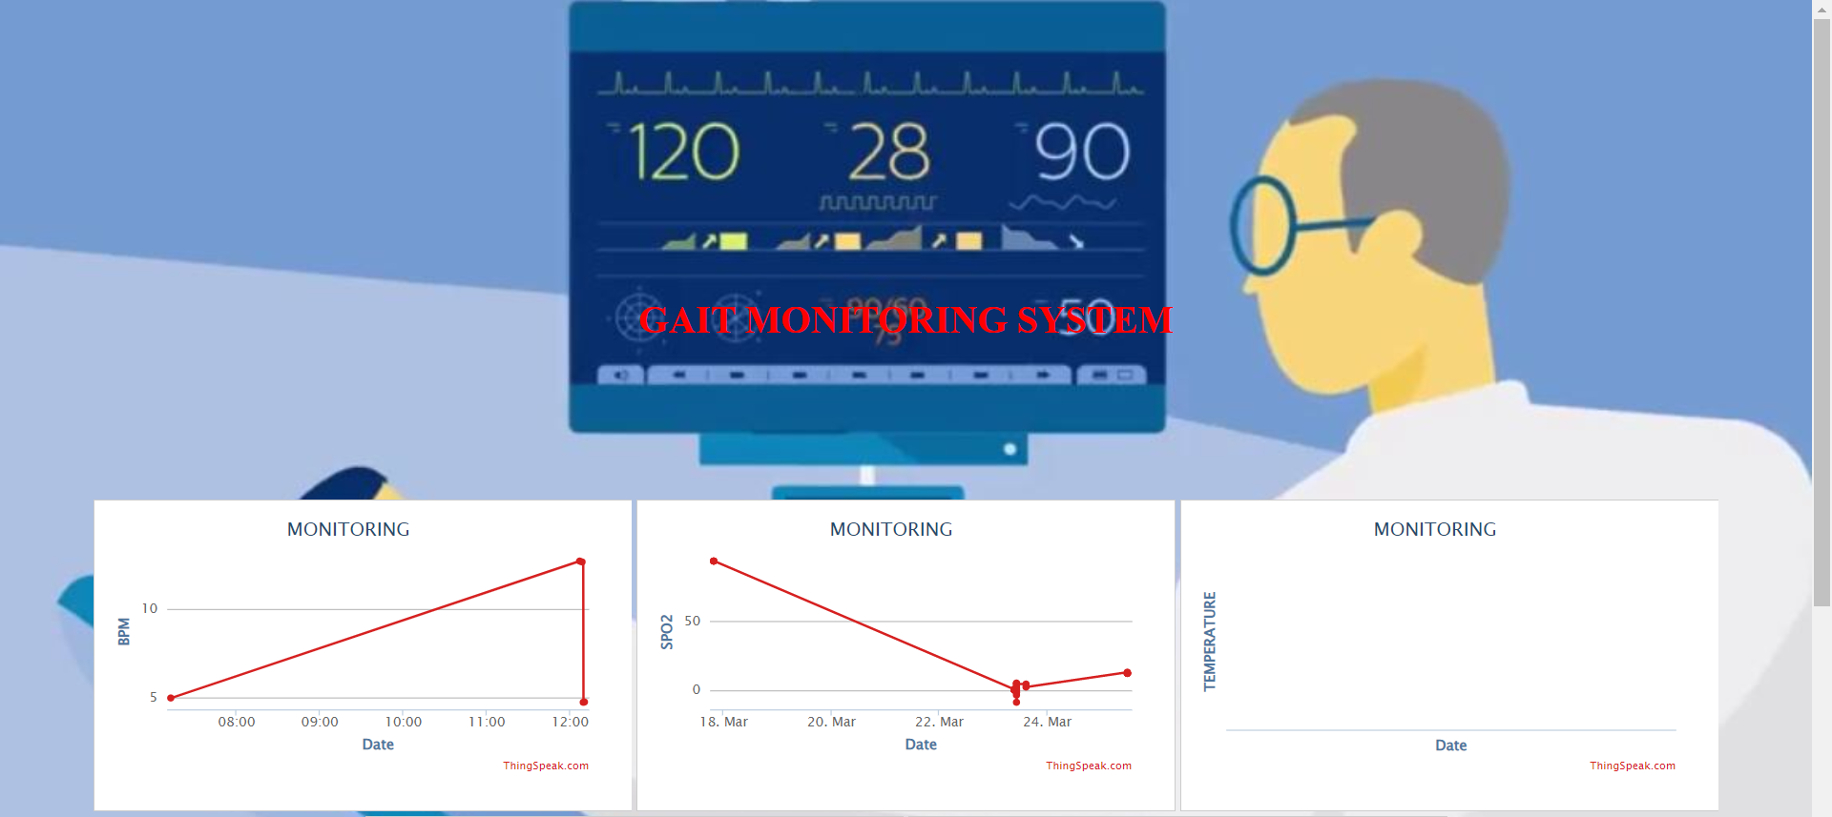
RESULTS

Slide 21
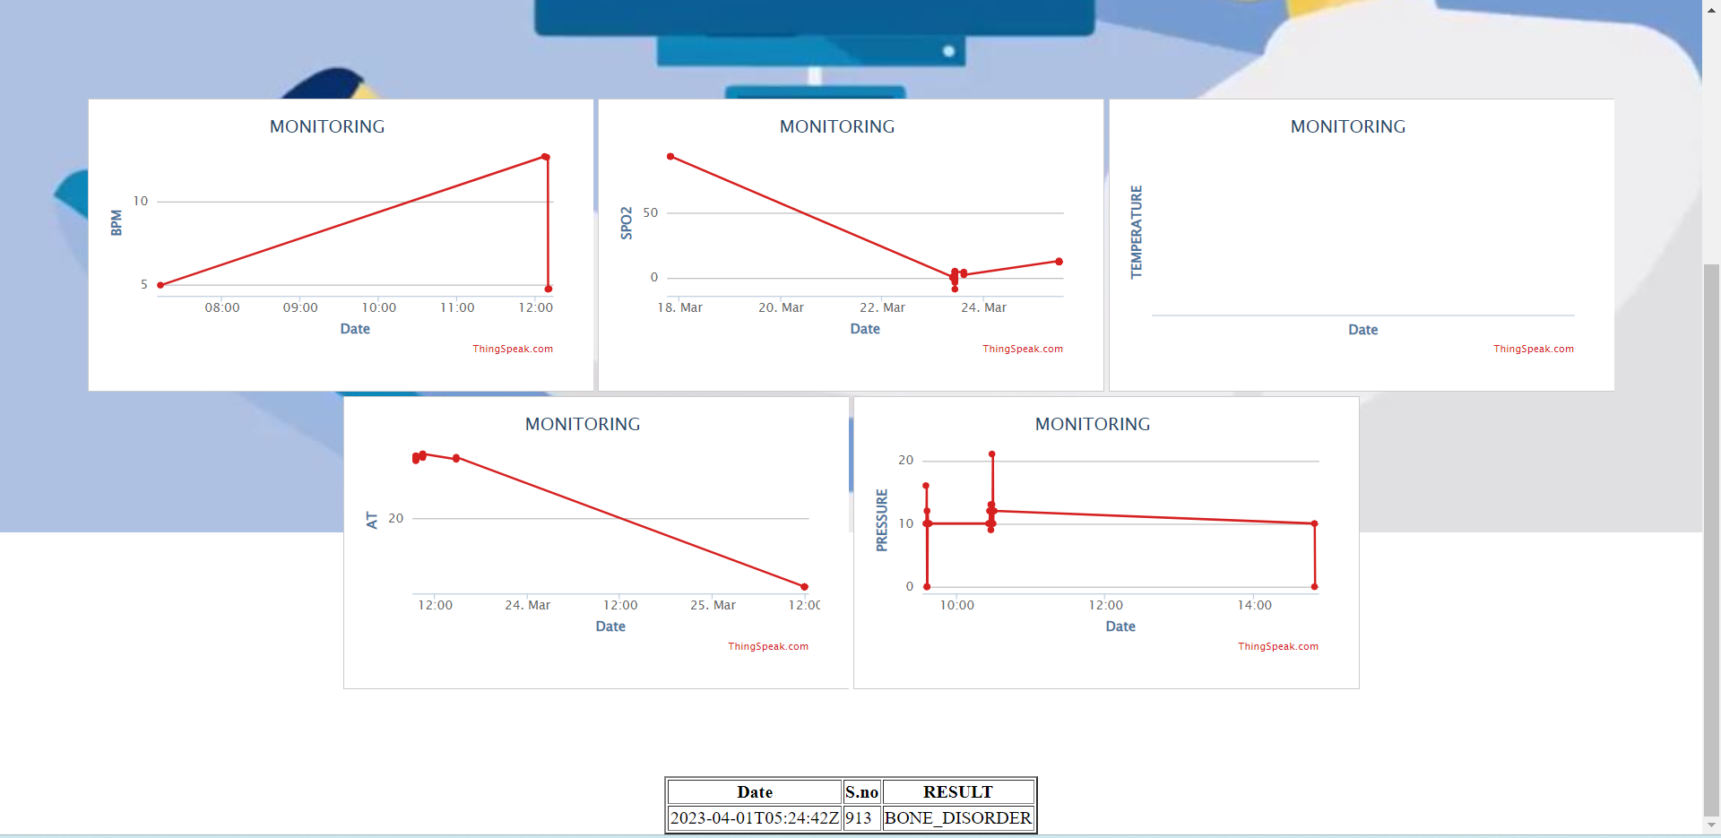
RESULTS

Slide 22
RESULTS
ALGORITHMS | ACCURACY
KNN | 92.5%
SVM | 90.45%
DECISION TREE | 91.24%

Slide 23
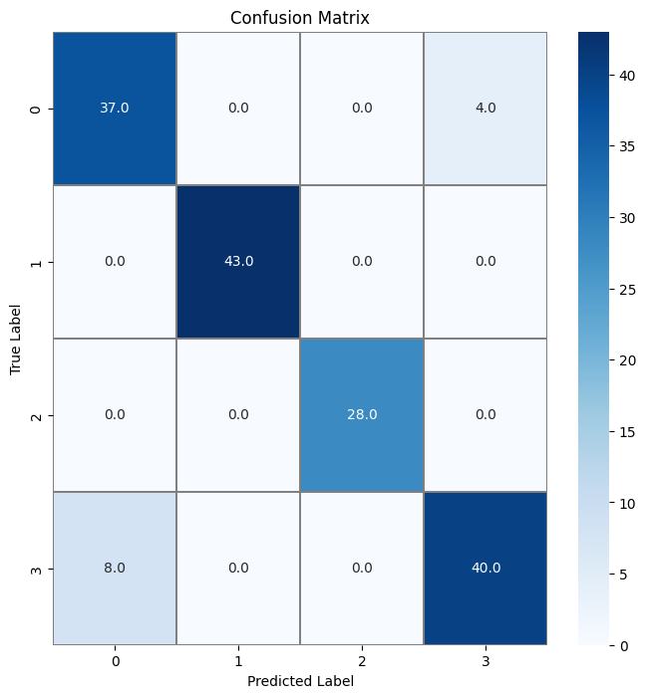
RESULTS

Slide 24
CONCLUSION
Real-time orthotic leg analysis using AI and IoT holds great potential in revolutionizing the field of orthotics by providing personalized, accurate, and real-time feedback to patients. By leveraging the power of AI and IoT, clinicians and patients can track the effectiveness of orthotic devices and make necessary adjustments in real-time, improving patient outcomes and quality of life. Moreover, this technology can also help reduce healthcare costs associated with frequent visits to clinics and hospitals for adjustments and maintenance. While there are still some challenges and limitations to be addressed, the advancements in AI and IoT offer exciting possibilities for the future of orthotics.

Slide 25
FUTURE SCOPE
Potential future scope is the development of smart orthotic devices that can automatically adjust themselves based on the patient's gait or activity level, without requiring external intervention. This could greatly improve patient comfort and reduce the need for frequent adjustments and maintenance.
And also to introduce an messaging system through which the doctors could recommend exercise videos and instructions to help patients go back to normal and healthy life.

Slide 26
REFERENCES
[1] Agrawal S ,Banala K, “Assessment of motion of a swing leg and gait rehabilitation with a gravity balancing exoskeleton” IEEE Trans. on Neural Systems and Rehabilitation Engineering, Vol. 15, no. 3, pp. 410-420, September 2007.
[2] Khamar J ,“Human-exoskeleton control simulation, kinetic and kinematic modelling and parameters extraction Methods X” , Vol.1, no.3, pp.1-5.June 2020.
[3] Safizadeh M ,Hussein A, “Kinematic analysis of powered lower limb orthoses for gait rehabilitation of hemiplegic and hemiparetic patients”, Intl. Journal of Mathematical Models and Methods in Applied Sciences, Vol. 5, no. 3, pp. 490-498 August 2019.

Slide 27
REFERENCES
[4] Yamamoto K,M. Ishii, “Development of power assisting suit (miniaturization of supply system to realize wearable suit),” JSME Intl. J., Ser. C, vol. 46, no. 3, pp. 923–930 November 2019.
[5] Zhang Q,Tian H,“ Development of an Instrumented and Passive Exoskeleton for the Lower Limb Rehabilitation”, in Proc. of the Conference of Intl. Association of Computer Science and Information Technology, 2009, pp. 521-525 March 2019.
[6] C. Lou et al., “A Graphene-Based Flexible Pressure Sensor with Applications to Plantar Pressure Measurement and Gait Analysis,” Materials, vol. 10, no. 9, p. 1068, Sep. 2017.

Slide 28
REFERENCES
[7] T. Tsai, S. Lee, and S. Chang, “Detection System for Capacitive Plantar Pressure Monitoring,” IEEE Access, vol. 8, pp. 42633-42655, 2020.
[8] X. Lin, and B. Seet, “A Linear Wide-Range Textile Pressure Sensor Integrally Embedded in Regular Fabric,” IEEE Sensors Journal, vol. 15, no. 10, pp. 5384- 5385, 2015.
[9] X. Lin, and B. Seet, “Battery-Free Smart Sock for Abnormal Relative Plantar Pressure Monitoring,” IEEE Transactions on Biomedical Circuits and Systems, vol. 11, no. 2, pp. 464-473, 2017.
[10] L. Motha, J. Kim, and W. S. Kim, “Instrumented rubber insole for plantar pressure sensing,” Organic Electronics, vol. 23, pp. 82-86, Aug. 2015.

